Slide 1
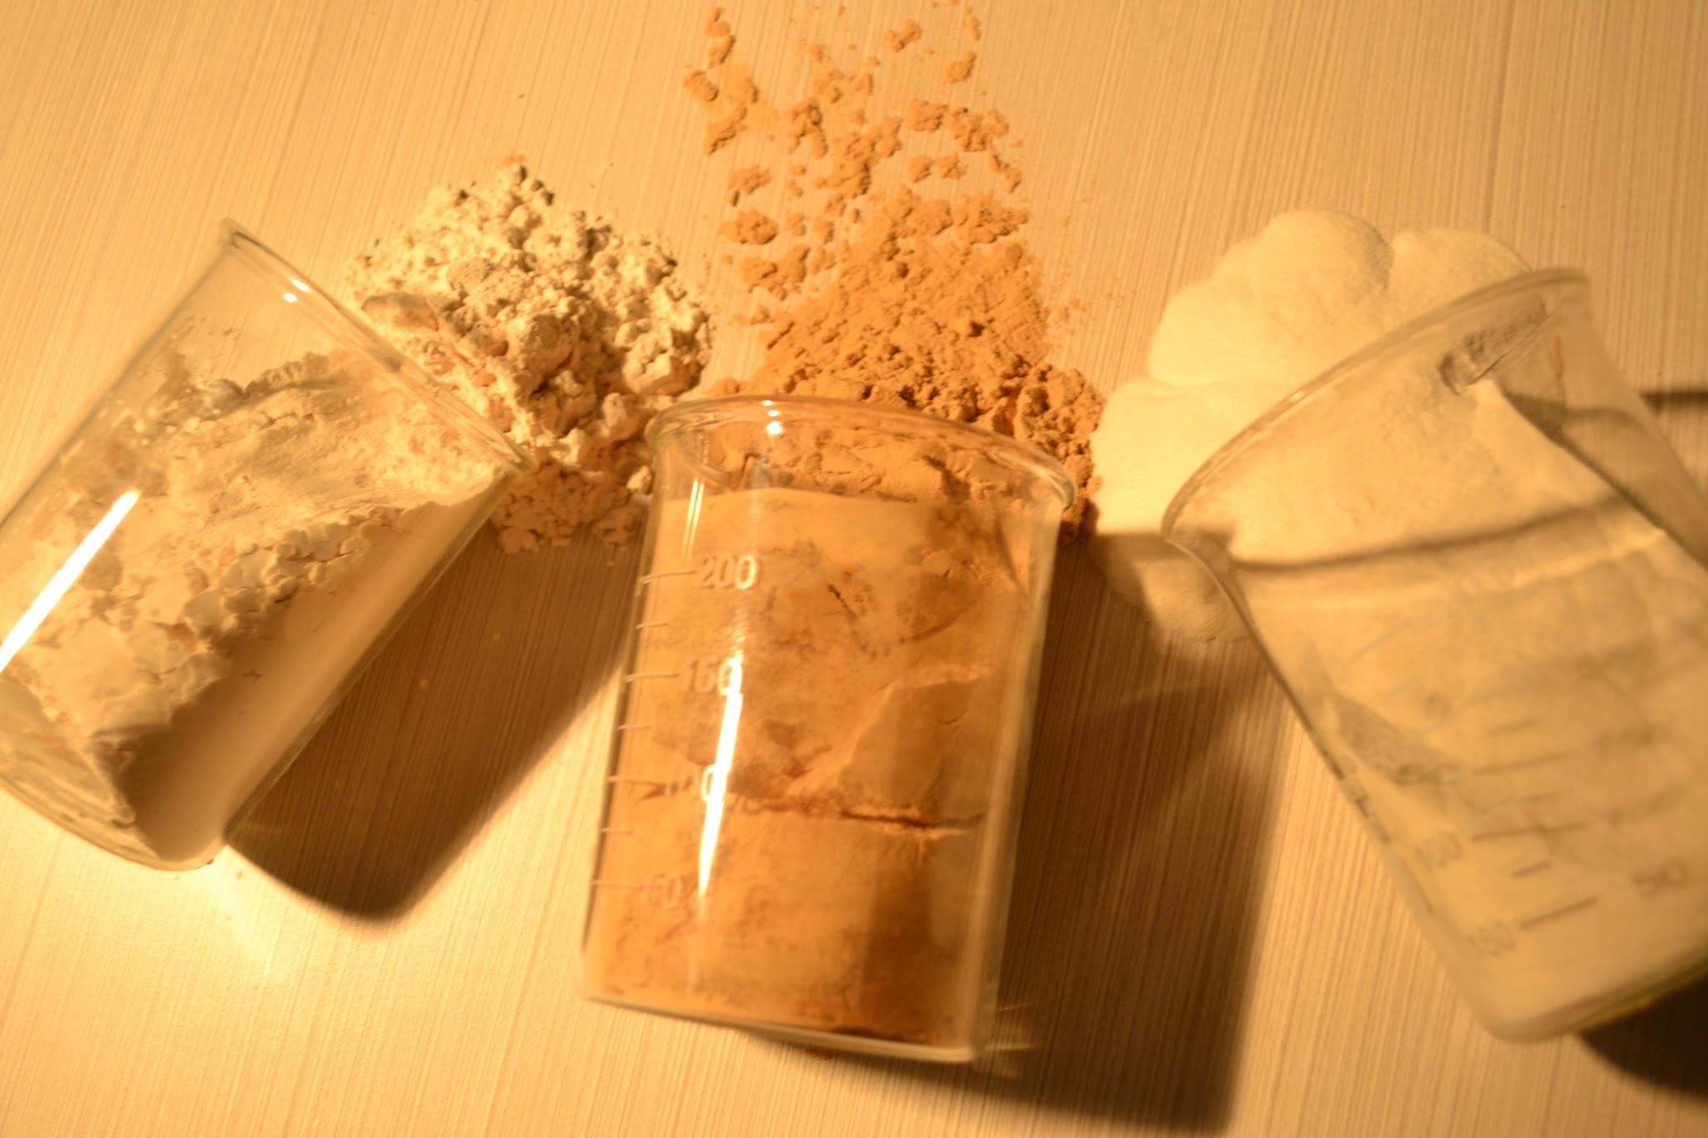
Starch Adhesives in Corrugation Industry
Amylodex Pvt. Ltd 02 Oct 2017 at WICMA level II course Bhaskar BV Reddy

Slide 2

Objective
To understand Starch Adhesives and evaluate various options available with the help of few testing parameters
Amylodex Pvt. Ltd 02 Oct 2017 at WICMA level II course Bhaskar BV Reddy

Slide 3
Topics
Introduction to Starch Adhesives.
Classification Of Starch Adhesives
Testing Parameters and Testing Instruments.
Special Additives
New developments
Amylodex Pvt.Ltd 02 Oct 2017 at WICMA level II course Bhaskar BV Reddy

Slide 4
introduction
Why we need Adhesive
  To stick various plies of Kraft Paper
  To get good strength to Board
What is starch adhesive
  When starch is heated in water , it will transform into a paste like structure.
  For stronger bonding chemicals are added.
Other adhesives other than starch
  Yes. Like Sodium Silicate. Very few use
Amylodex Pvt. Ltd 02 Oct 2017 at WICMA level II course Bhaskar BV Reddy

Slide 5
Classification of Starch Adhesives
Application
  Corrugation Adhesives
  Pasting Adhesives
Starch Base
  Tapioca Starch
  Maize Starch
Physical form
  Liquid Starch Adhesives
  Powder Starch adhesives
Preparation Method
  Hot Process Starch Adhesives
  Cold Process Starch Adhesives
Amylodex Pvt. Ltd 02 Oct 2017 at WICMA level II course Bhaskar BV Reddy

Slide 6
Classification of Starch Adhesives …….
pH
  pH>7 is alkaline
  pH=7 is Neutral
  pH<7 is acidic
Type of manufacturing
  Manual / Semi Auto Plant
  Auto Plant
  Hybrid Plant
Amylodex Pvt. Ltd 02 Oct 2017 at WICMA level II course Bhaskar BV Reddy

Slide 7
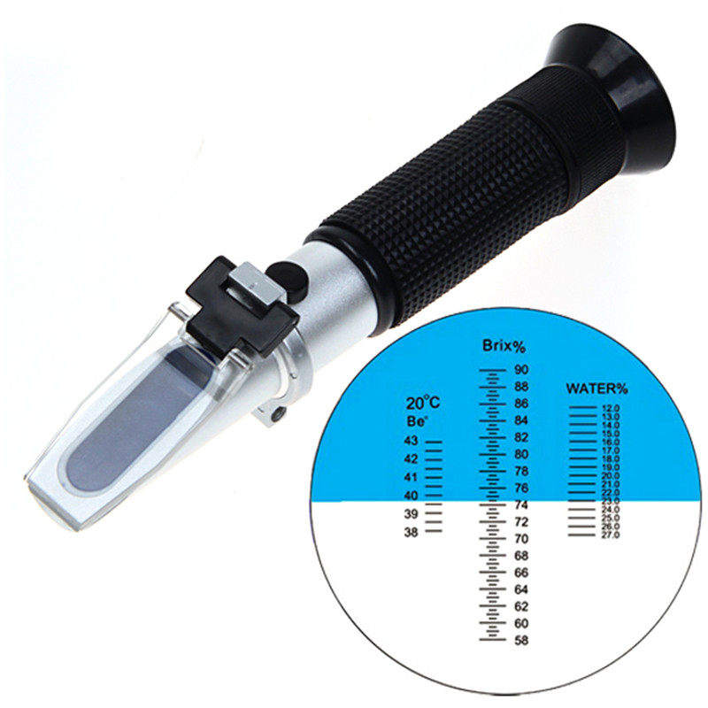
Testing Parameters
Solids
  Expressed in % and shows how
  much starch/Modified Starch/chemicals are present in Adhesives.
  Refractometer is used if adhesive is solution.
  Owen method- If adhesive is suspension
  This parameter signifies how much of water needs to be dried in the Board making process.
Amylodex Pvt. Ltd 02 Oct 2017 at WICMA level II course Bhaskar BV Reddy

Slide 8
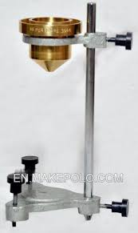
Testing Parameters
Viscosity
  Resistance to Flow
  Measured in Sec. Time taken to drain out
  Many cups are used. Fords Cup,Love Cup, Brookefield , RVA
  Very important for stable operations and needs to be consistent.
  Normally Manual plants operate at 25-35 sec for Pasting and Corrugation adhesives ( B4 cup)
  Auto Plants operate at 40 to 120 sec (B4 )
Amylodex Pvt. Ltd 02 Oct 2017 at WICMA level II course Bhaskar BV Reddy

Slide 9
Testing Parameters
Other testing Parameter
  Gel temperature.
  Tack measurement
  Glue setting time / Green bond formation
  Thixotropic behaviour.
  Gel clarity in case of Pasting Adhesives.
Amylodex Pvt. Ltd 02 Oct 2017 at WICMA level II course Bhaskar BV Reddy

Slide 10
Special Additives for adhesives
Drying agents
Green Bond enhancers
Resins for Water Proof / Water Resistance
Penetration aids
Mechanical property enhancers.
Liquid Borax
Biocides
Anti-foam agents
Viscosity Stabilizers
Amylodex Pvt. Ltd 02 Oct 2017 at WICMA level II course Bhaskar BV Reddy

Slide 11
New Developments in adhesives
Very high solids (33% to 50% ) adhesives for Flute laminators for instant drying
Powder Resins for higher compression in Manual operation
Borax substitutes
Energy saving adhesives ( to the extent of 25% )
Green Adhesives / Environmental friendly Adhesives.
Adhesives without Borax and Caustic.
Amylodex Pvt. Ltd 02 Oct 2017 at WICMA level II course Bhaskar BV Reddy

Slide 12

Thank You
Bhaskar BV Reddy
Amylodex Pvt.Ltd. (Formerly Stardex)
bhaskar@amylodex.com
Tele: 040 – 23060334 Fax: 040 - 23061638
Mob: 9866114029
www.amylodex.com

